Slide 1
Cainan Black Senior Project
Java Calculator Application

Slide 2
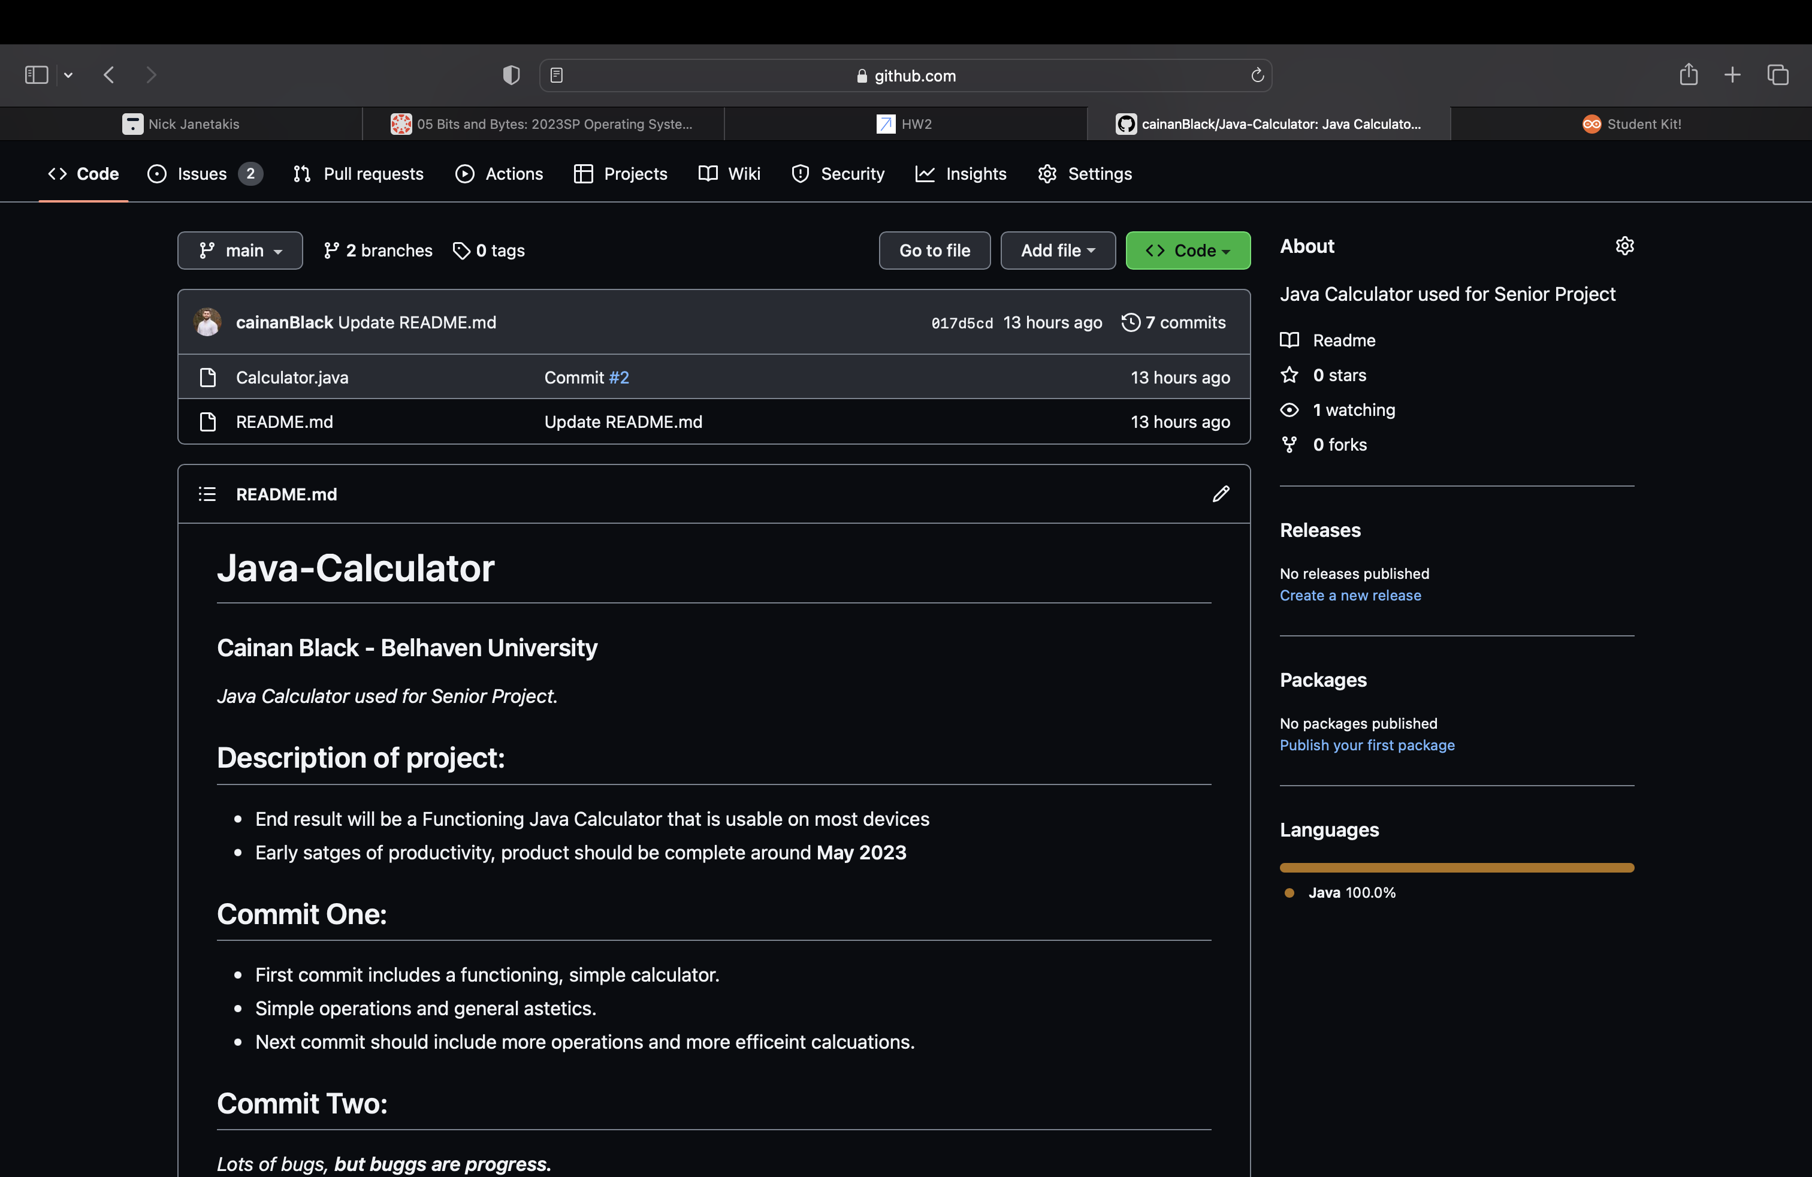
Git Repo
Added all the code and slides to the gitHub repo.
Second commit is up, lots of new issues to work on.

Slide 3
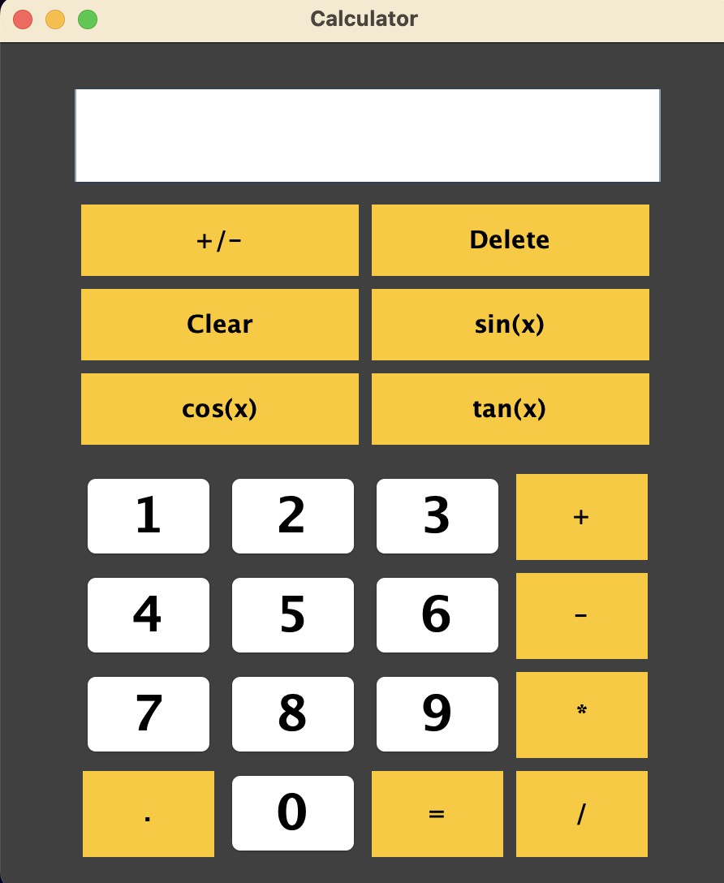
How it looks, for right now:
Added a little more functionality with some sin, cos, and tan buttons.
Added a new JPanel to better store the function buttons, rather then just having them floating around the frame.

Slide 4
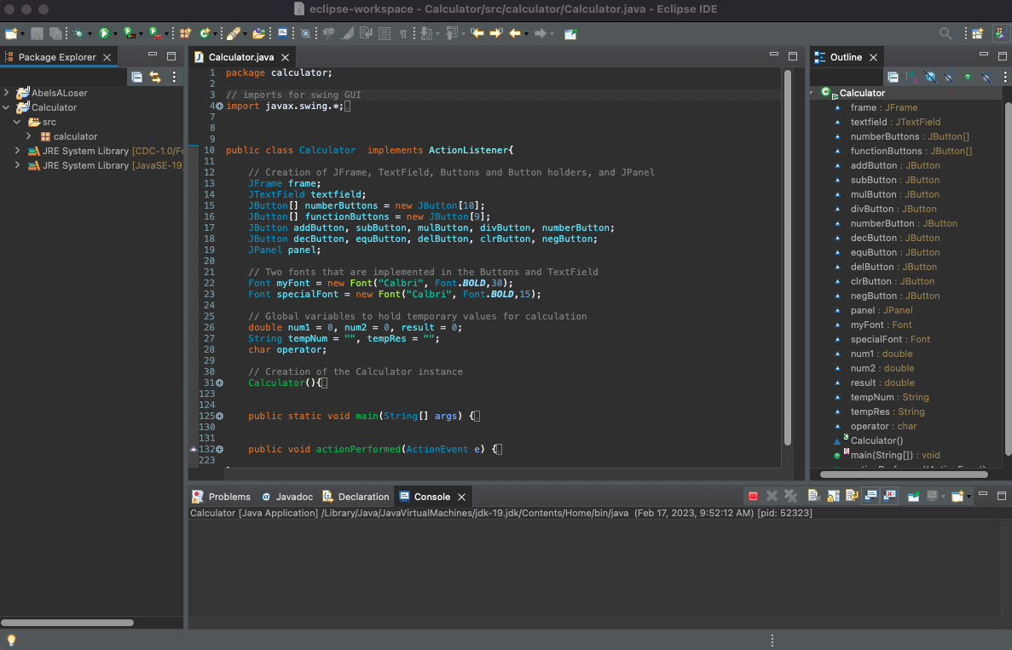
Main Code:
Very small and hard to read, sorry! (Code is in the repo if you want to look at it closer)
Not too much has changed. More buttons, new text field (The way those are done will definitely change in the future.), new JPanel.

Slide 5
Work for next week
More functions
Order of operations
Streamline the back end; a lot of things back there are done a little goofy for progress.

